Slide 1
Cooking with AWS and Splunk
Module 5 : Troubleshooting the Splunk App / Add-on for AWS
Kam Amir | Splunk Cloud Architect

Slide 2

Troubleshoot AWS App
Checking Inputs and _internal indexes
Index Workflow
Splunk AWS App Index Workflow
Sending data to new index not main
Enable DEBUG for the Add-on
Search indexes (main, _internal)
cURL Command for HEC / Lambda Testing
AWS App Configuration Settings
Saved Searches
Lookup
Data Models
Macros
Config Dashboard Fix
Notes:
Troubleshooting the Splunk App and Add-on for AWS requires an understanding of both Splunk and AWS in order to help diagnose the issue. This workflow will help you to find out either what step was missed or which item needs to be configured properly. We will start with looking at how this app treats the indexes and how that impacts working dashboards. Then we will go over some steps to help diagnose the issues within the Splunk app and add-on; first by enabling the DEBUG function and then diving into searches to pinpoint possible issues. Next, we will test the HEC by running some simple cURL commands to validate the HEC is up and able to accept data. Finally, we will go over the App and look at components that could be preventing data from populating in the dashboards.

Slide 3
Index Workflow
How the data is indexed for the AWS App

Slide 4
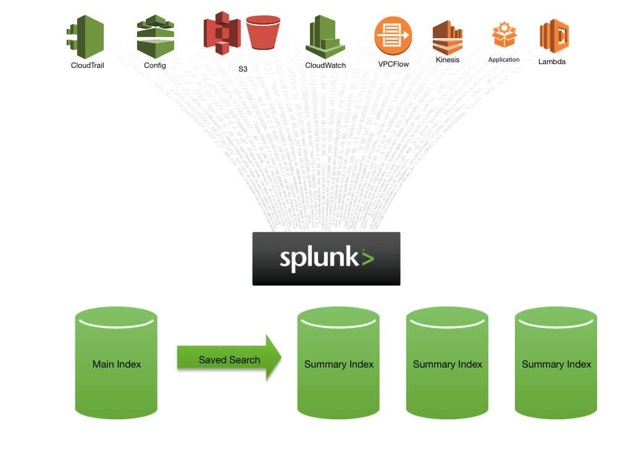
Splunk AWS App Index Workflow
By default the Splunk App for AWS and Add-on send the data into the Splunk Main (default) index. From there a saved search will run to populate the summary indexes.
The Summary Indexes are used to populate the dashboards in the Splunk App for AWS.
Sending data to custom indexes will require making changes to the macros supporting this app.
Notes:
The Splunk App for AWS contains an indexes.conf file which creates some summary indexes, in a distributed environment, the indexes.conf file should be distributed to the indexer tier. By default the data lands in the main index and then is summarized using saved searches and macros.

Slide 5
Sending data to new index not ‘main.’
This is when customers setup their own ‘aws’ index and start sending their data into that index instead of the default or main index.

Slide 6
Updating the index the App Uses
Steps to change sending data from default index to custom index
First, create a new index to send AWS data into.
Update the proper macros and make sure the saved searches are running to populate the summary indexes:
http://docs.splunk.com/Documentation/AWS/latest/Installation/Macros
Make sure the saved searches are properly running
http://docs.splunk.com/Documentation/AWS/latest/Installation/Savedsearches
Activity->Jobs-> filter for “vpc” and look for any jobs that failed
Search to see if there are any skipped searches: index=_internal sourcetype=scheduler app=splunk_app_aws | stats count,values(savedsearch_name) by status
Notes:
If a customer changes the default index where the data lands, search macros need to be updated to include this new index.

Slide 7
Enabling debug

Slide 8
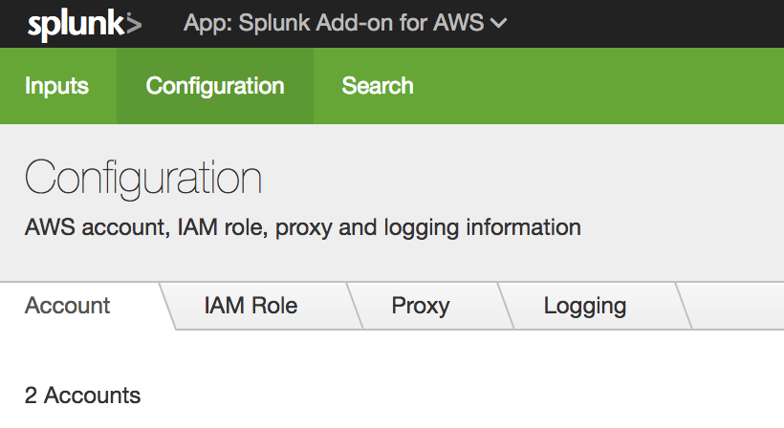
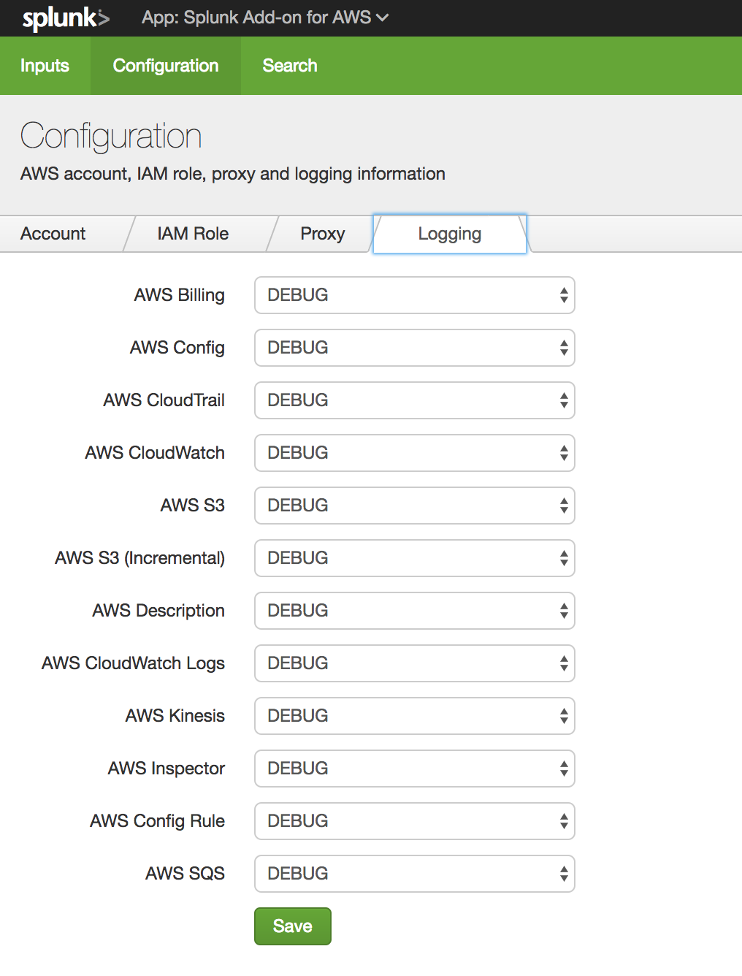
Enable DEBUG for the Add-on
Splunk Add-On for AWS
Configuration
Logging
Set to DEBUG
Notes:
Enabling DEBUG allows to see if the Add-on is having trouble connecting to any specific AWS Service. Log into the Add-on for AWS, to go Configuration, click on the Logging Tab and enable DEBUG on all the services that you are setting up. Click save.

Slide 9
Searching ’main’ and _internal indexes
Validate to see if data is coming into main index or custom built index.

Slide 10
Search main index
Validate Data is coming into Splunk:
index=main | stats count by sourcetype
Search lag from indexer to events
index=main sourcetype=aws:* | eval time=_time | eval itime=_indextime | eval latency=(itime - time) | stats count, avg(latency), min(latency), max(latency) by sourcetype
Search which indexes are being populated
index=aws* | stats count by index
Serverless (HEC)
index=_introspection sourcetype=http_event_collector_metrics
Notes:
This searches help validate if data is coming into the indexes and which source types are working. If there are any issues with latency or other possible issues, the indexer lag search can help determine if that is the problem. Searching to see if the summary indexes are populating can help determine which saved searches are not running. Finally, the serverless search can help determine if the HEC is operating correctly.

Slide 11
Search _internal index
Search _internal index
Validate errors by AWS Input
Index=_internal ERROR sourcetype=aws:*:log | stats count by sourcetype
Collect DEBUG messages
Index=_internal sourcetype=aws* DEBUG | stats count by sourcetype
Search for skipped or failed saved search jobs
index=_internal sourcetype=scheduler app=splunk_app_aws | stats count,values(savedsearch_name) by status
Group together errors by AWS service based on PID (helps with throttling, rate limits etc.)
index=_internal sourcetype=aws:* | transaction pid tid | dedup punct
Notes:
The first search will help determine if an input is having issues connecting to a specific AWS service. This might uncover a permission issue or improper data being sent into the input. Searching for skipped searches can help explain why some dashboards are not populating since the summary indexes do not have any corresponding data. Finally, the last search can help see if the input is being throttled by AWS.

Slide 12
cURL Command for HEC / Lambda Testing

Slide 13
cURL Command for HEC Testing
http://dev.splunk.com/view/event-collector/SP-CAAAE7F
Test from terminal:
Splunk Enterprise
bash$ curl -k https://<host>:8088/services/collector -H 'Authorization: Splunk <token>' -d '{"sourcetype": "mysourcetype", "event":"Hello, World!"}’
Splunk Cloud
bash$ curl -k -H "Authorization: Splunk <token>" https://http-inputs-mysplunkcloud.example.com/services/collector -H 'Authorization: Splunk <token>’ -d '{"sourcetype": "mysourcetype", "event": " Hello, World!"}’
Splunk Cloud Trial
bash$ curl -k https://input-<trial_name>.cloud.splunk.com:8088/services/collector -H 'Authorization: Splunk <token>' -d '{"event":"Hello, World!"}'
Notes:
These cURL commands are used to determine if the HEC port, Load Balancer or endpoints are able to accept data. Each one of these commands is specific to the Splunk platform you are sending your data into, the only difference will be the URL of your Splunk instance. For example, Splunk Cloud instances have a Load Balancer in front of the indexers which help distribute the load across the indexing tier.

Slide 14
Testing Lambda Function
Simple test to validate Lambda function is sending data to Splunk HEC

Slide 15
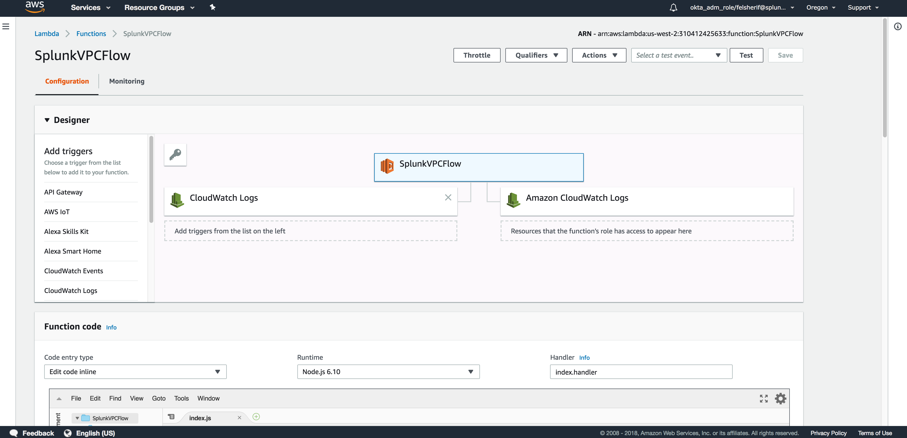
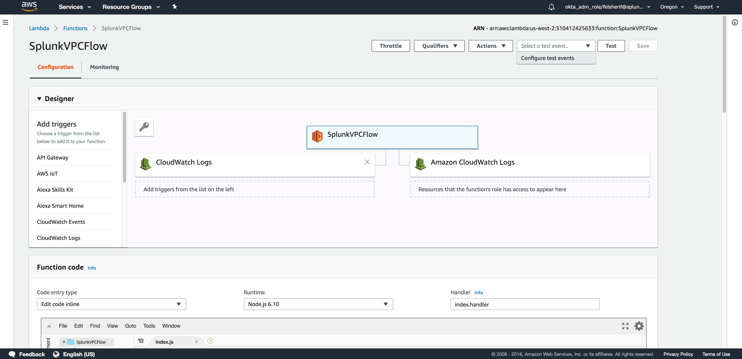
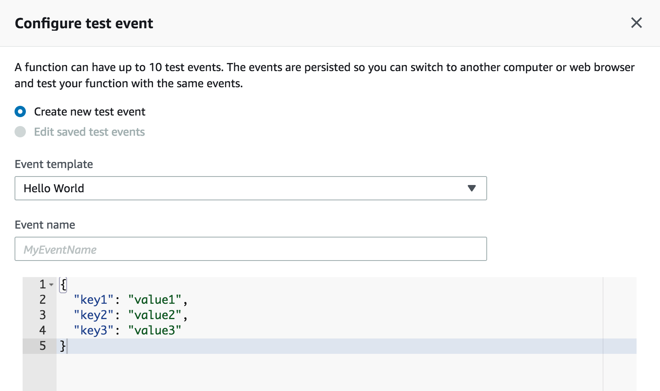
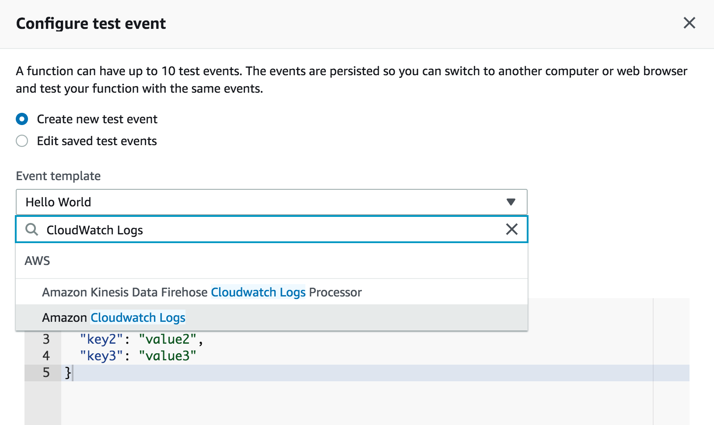
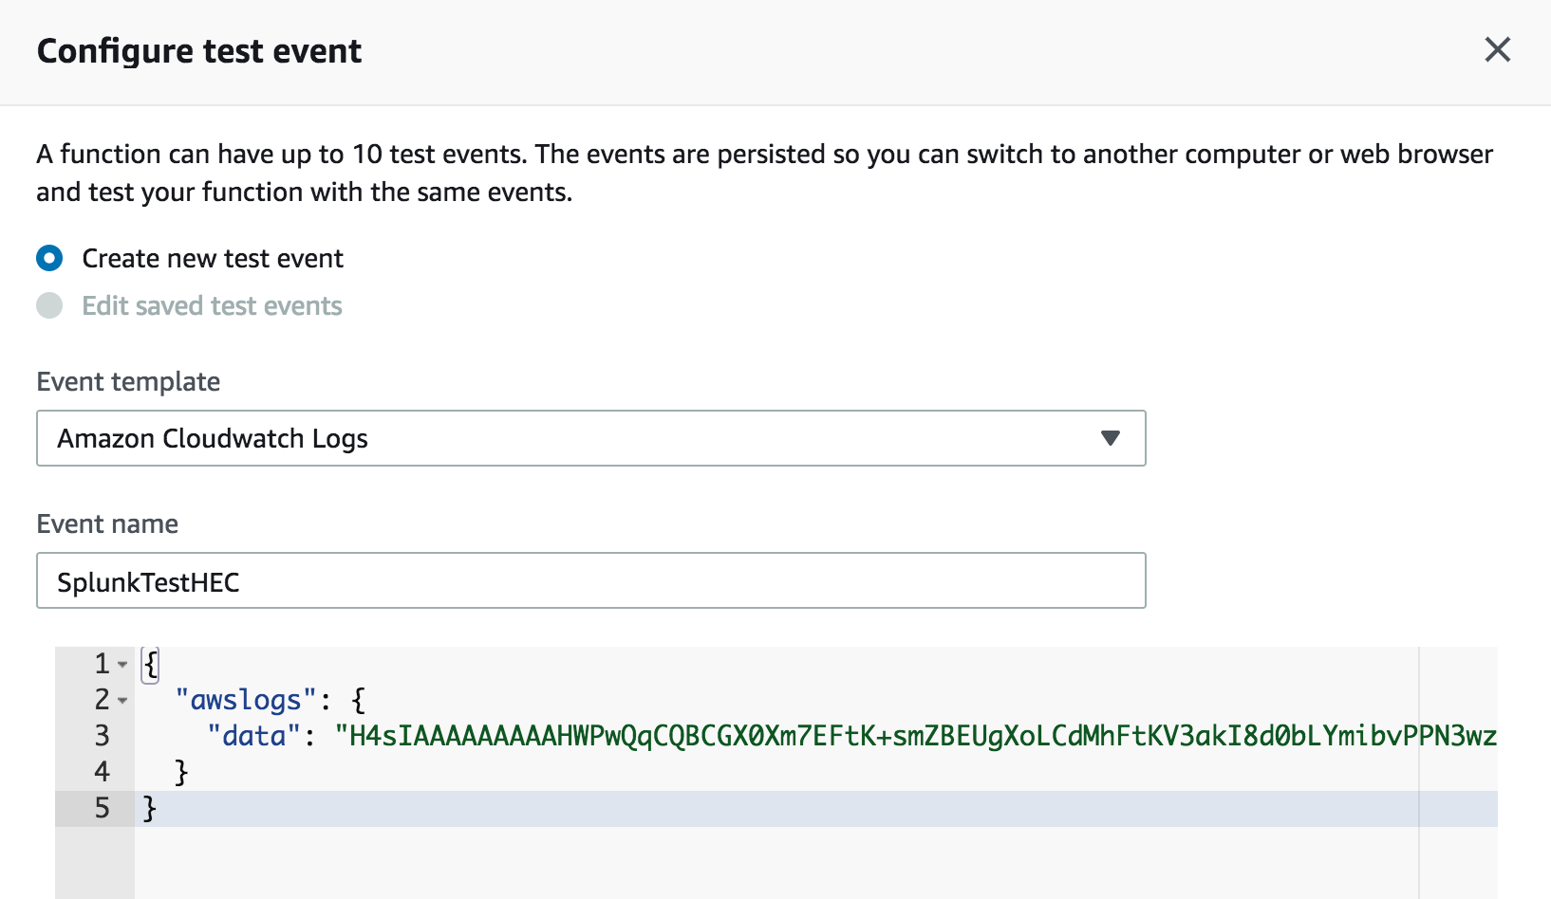
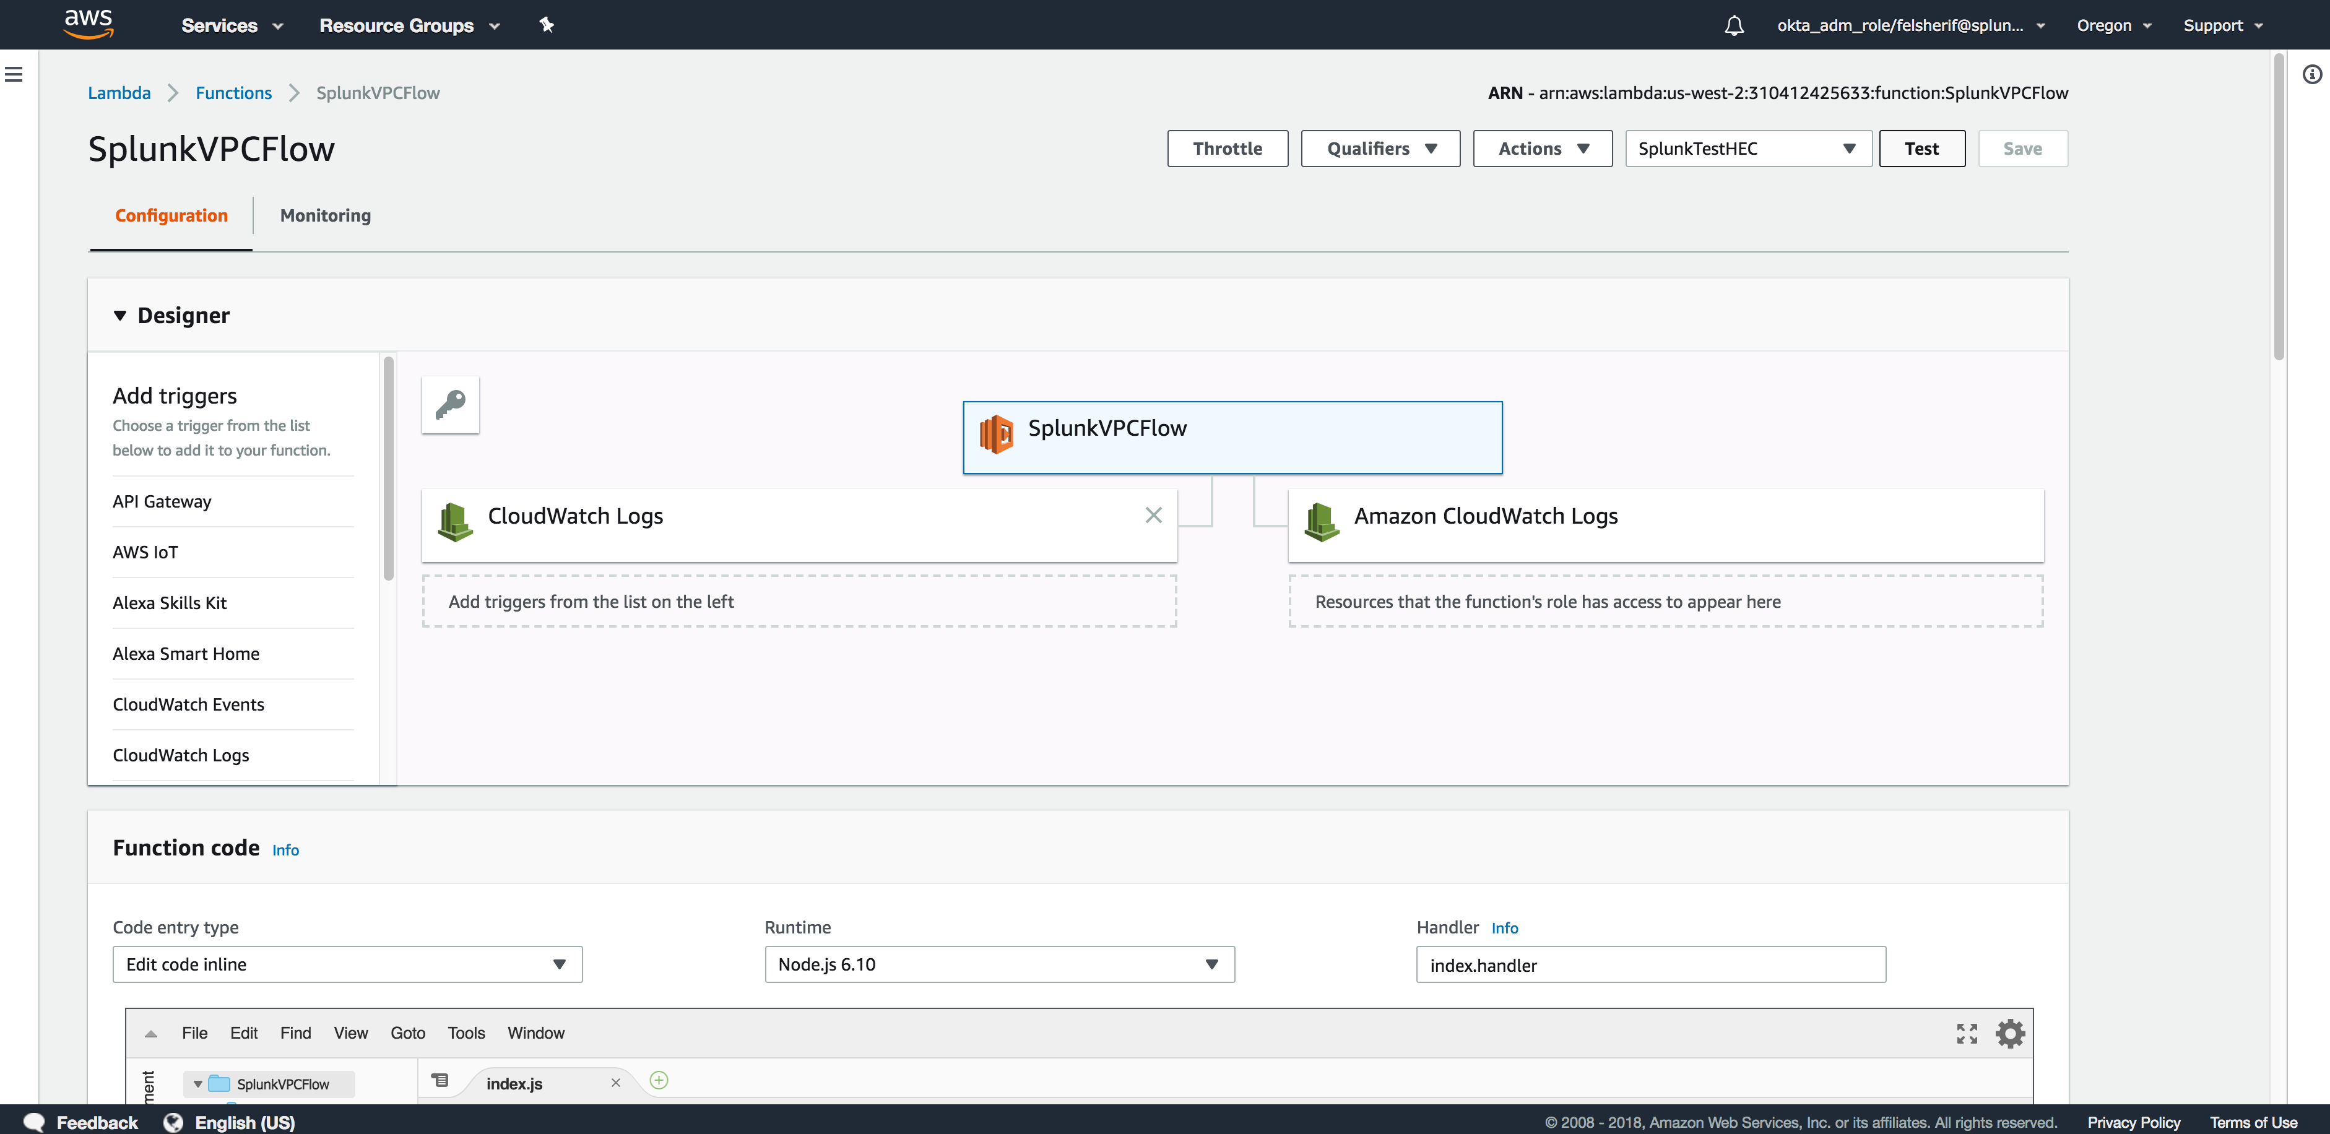
Testing Lambda Function
Create Test using CloudWatch Logs event
Click drop down by Test
Configure test events
Click on the Event Template
Execute the test
Change the template to Cloudwatch Logs
Name the test
Notes:
From AWS, you can test to see if the data is being sent into your Splunk deployment and that the Lambda function is not running into any issue. Once you have selected your function to test, make sure to select the template for Cloudwatch Logs before running the test. If the test fails, see the CloudWatch logs for the lambda function and it should be able to tell you where the failure is occurring. A common issue is a wrong URL for Splunk. Make sure you are sending to an HTTPS endpoint (secure); unsecured endpoints are generally not setup by default.

Slide 16
AWS App Configuration Settings
Check these configuration settings and make sure they are working

Slide 17
Troubleshoot App: Macros
http://docs.splunk.com/Documentation/AWS/latest/Installation/Macros
Macros are found in the UI Settings -> Advanced Search -> Search macros
If you change the default index Splunk is sending the AWS data, then modify the index macro to include the new index. This will impact the dashboards, reports, saved searches and summary indexes in the app.
Config Macro : aws-config-notification-sourcetype needs to be changed to `aws-config-index` sourcetype=aws:config source="*ConfigHistory*”
This change will enable the dashboards to work with the new SQS Based S3 input and populate the config based dashboards.

Slide 18
Troubleshoot App: Saved Searches
http://docs.splunk.com/Documentation/AWS/latest/Installation/Savedsearches
Saved Searches are used to populate the Summary indexes, create lookup files, create the topology, extract tags, update macros and much more.
Validate that the saved searches are running if you’re missing any dashboards or data in the app.
Run this search to validate the saved search ran:
index=_internal sourcetype=scheduler app=splunk_app_aws | stats count,values(savedsearch_name) by status

Slide 19
Troubleshoot App: Lookups
http://docs.splunk.com/Documentation/AWS/latest/Installation/Lookups
Lookups are used to enrich the data in the AWS app. This includes the prices for EC2 instances as well as regions.
They can be found $SPLUNK_HOME/etc/apps/splunk_app_aws/lookups

Slide 20
Troubleshoot App: Data Models
http://docs.splunk.com/Documentation/AWS/latest/Installation/Datamodels
The AWS Data Models are accelerated by default and help with the dashboard performance

Slide 21
Dashboard Config Fix
Setting up aws:config to work properly
Modify the aws-config-notification-sourcetype macro:
`aws-config-index` sourcetype=aws:config source="*ConfigHistory*”
Modify the Dashboard XML
Find and replace “configurationItemDiff.changeType” to “action”
Find and replace “UPDATE” to “modified”
Find and replace “DELETE” to “deleted”
Find and replace ”CREATE” to “created”

Slide 22
Continue to Module 6 : Cloud Formation Templates

